Slide 1
Critical Thinking

Slide 2
A Thought Experiment
A judge tells a condemned prisoner that, “he will be hanged at noon on one weekday in the following week but that the execution will be a surprise to the prisoner.”. He will not know the day of the hanging until the executioner knocks on his cell door at noon that day.
Having reflected on his sentence, the prisoner draws the conclusion that he will escape from the hanging. However, he is hung, by surprise, on noon Wednesday.
How did the prisoner construct this logical argument?
What are the potential flaws?

Slide 3
You’ll need to critically evaluate results and sources throughout your life

Slide 4
“critical thinking is about taking a step back and thinking logically and carefully about the information you have, rather than believing everything you read, see and hear.” (Aveyard 2011, p.8)

Slide 5
A Thought Experiment
The most obvious link between critical thinking and writing is in the use of writing to represent the process of thinking. Some people can better express what is in their minds than others because, for example, they have better capacity with language. The capacity to write clearly and precisely is particularly associated with critical thinking, both in the sequencing and layout of evidence, but also in the broader summing up of the case. (Moon, 2005)

Slide 6
“knowledgeable doer – someone who selects, combines, judges and uses information in order to proceed in a professional manner.” (Wade and Travis, p.7)

Slide 7
All of the following Newspaper headlines are based on Scientific studies!

Slide 8
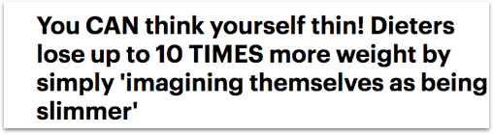
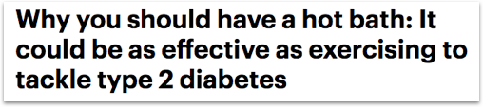
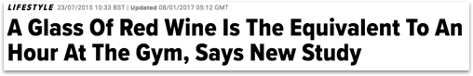

Slide 9
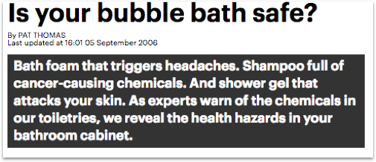
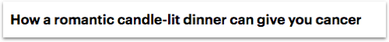

Slide 10
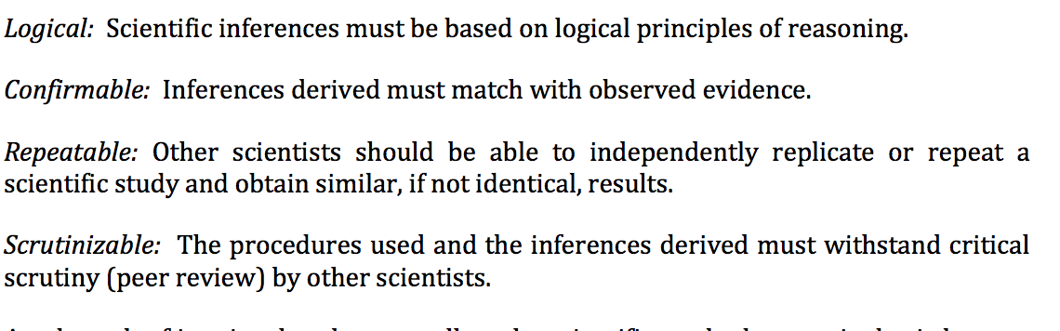
Terminology: Science
(Bhattacherjee 2012, p.8)

Slide 11
Terminology: Peer Reviewed journal Publication

Slide 12
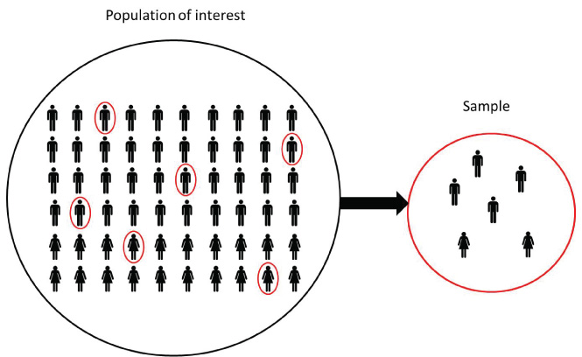
Terminology: Populations AND SAMPLE

Slide 13
Terminology: Hypothesis
Can A Chat Bot Increase Learning?
H0: Mean
H0: Mean Grade = C1
H1: Mean Grade > C1
SIGNIFICANCE P < 0.05

Slide 14
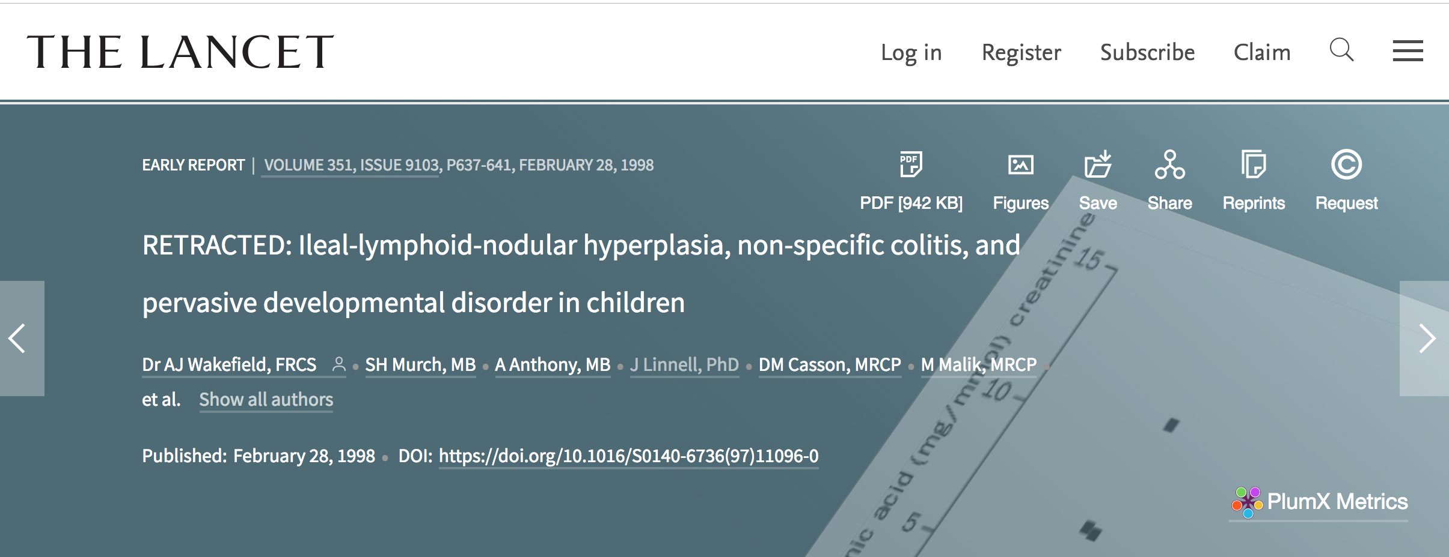

Slide 15
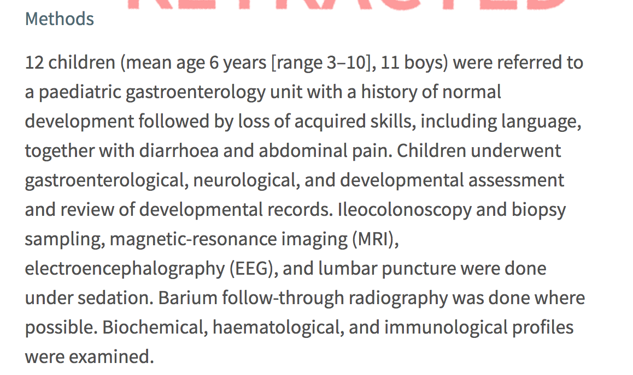

Slide 16
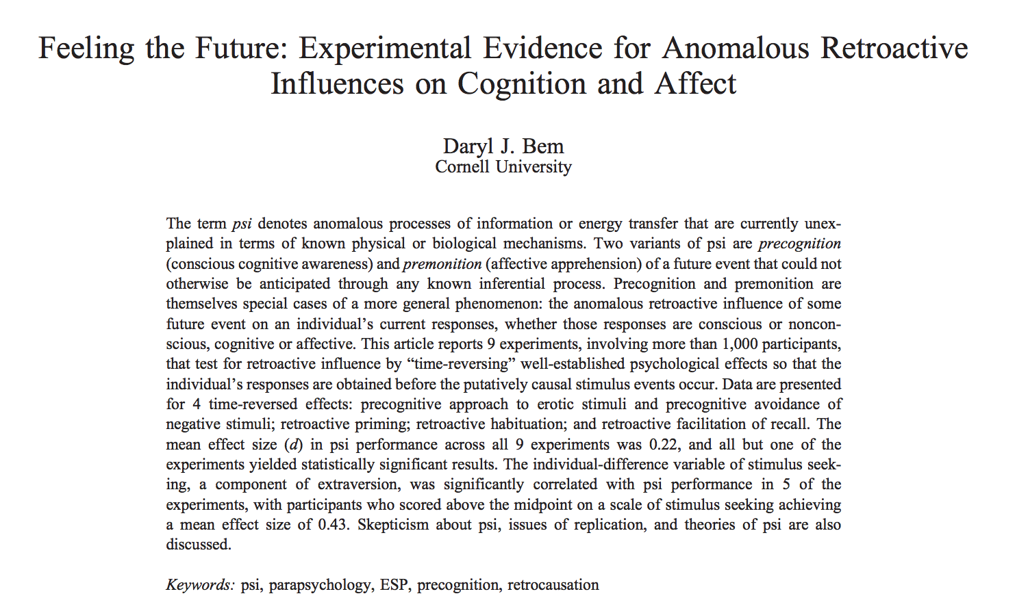

Slide 17
The Reproducibility Project - 97 studies only 35 of the studies replicated (36.1%)
https://youtu.be/0Rnq1NpHdmw?t=259

Slide 18
The Trap Of Readily Available Information

Slide 19
- Newspaper Articles - Product Blogs - Promotional Articles - Wikipedia

Slide 20
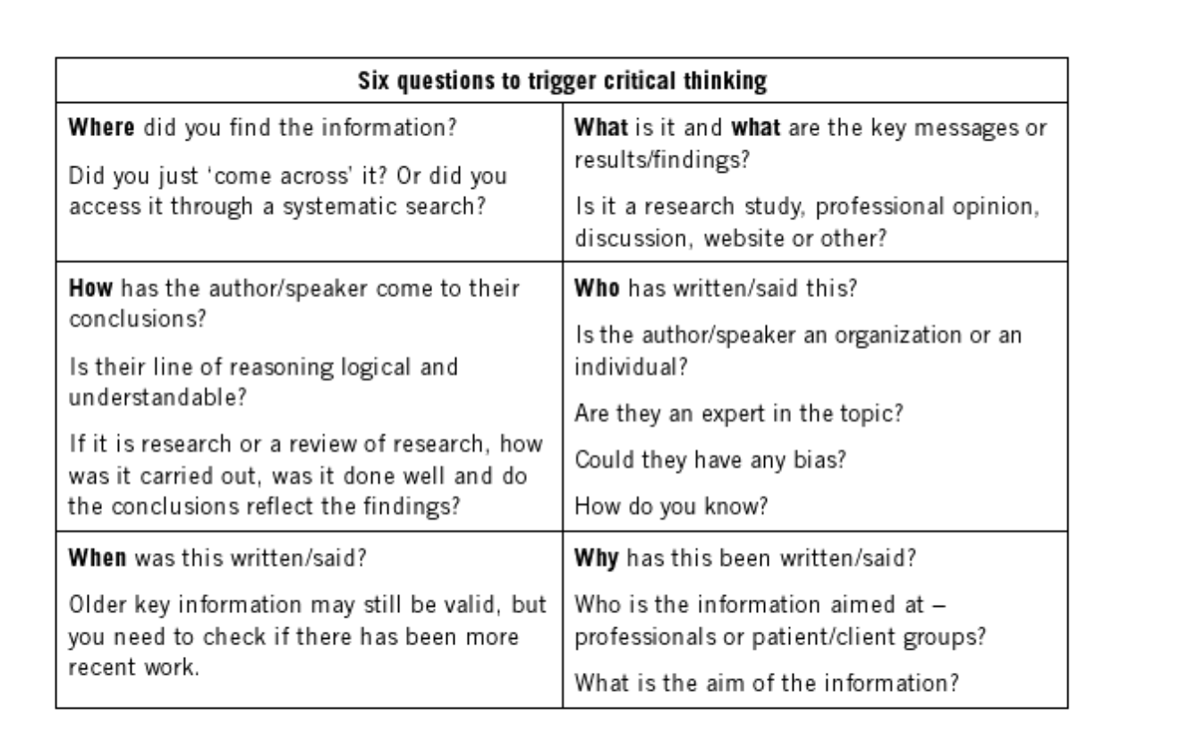
A Framework To Think Critically (AveYARD 2011)

